Slide 1

(Digital) Reproducible Science
August 2023
Joseph Gum
Notes:
This presentation was originally developed for OceanHackWeek 2019, and presented to mostly grad student scientists with a smattering of researchers. Parts of this talk may not apply to your audience and should be edited as needed.

Slide 2

Quiz time!
What is a repository?
Differences between code and data repositories?
Who do you turn in your data/results to?
Is your code publicly accessible?
Name a version control software (VCS)
What is a branch in git?
What is a package in Python?
Have you had trouble running code from others, or sharing your code?
Is interoperability important to you?
Do you feel there are too many standards to understand?
Standards - xkcd.com
Notes:
If you are a data center you might have a higher level repository you submit data to, for example NCEI. Otherwise reframe the question as “where do you put your code to make it publicly accessible?”

Slide 3







(Oceanography) Data Stewards Salad
ESIP
RDA
EarthCube
FAIR
Ocean Best Practices
DataONE
IEDA
Force11
And so on…
Notes:
For those in oceanography, this represents a collection of people representing the best interests of the public with respect to data (Go Fair, Force 11) and scientists with respect to data (ESIP, RDA, EarthCube). Alter to fit your needs as necessary

Slide 4
An Opinion of Three Cities: Science, Data, and Software
Science focused:
Three “R”s of Science - Repeatability, Replicability, Reproducibility
Reproducibility and Replicability in Science, 2019
The Replication Crisis in Science
Solving the Sharing of Software and Data
FAIR and CARE principles
Data centers/repositories
Methods repository - Ocean Best Practices
Software focused:
Community Decisions in Oceanography
Working environment: package managers, virtualization
Online interactive notebooks: Binder
Version control: git, Github
Code readability: formatters
Code readability part 2: docstrings/comments, autodocs
Variable names and standard vocabularies
Advanced software engineering
Licensing code and data
DOIs for code and data
Notes:
Index slide of the talk in its two parts.
Why “Opinion”? Opinion can be understood as another word for standard. You might’ve heard of opinionated Python/software, about the best recommended ways to do one thing, we’re going to cover some recommendations towards science and software that should help in doing reproducible science.

Slide 5
Reproducible Science: Making Reproducible Experiments Possible
Notes:
Flamebait title: This is meant to grab attention.
What do we mean by this? With computers and software increasingly used for analysis with details that can get away from us, we need new rigor and methods to keep ourselves from being lost in the details. Let’s talk about some of the fundamentals of reproducible science in order to figure out what our goals should be.

Slide 6
Three “R”s of Science
Repeatability: Same team, same experimental setup
Replicability: Different team, same experimental setup
Reproducibility: Different team, different experimental setup
Methods reproducibility: provide sufficient detail about procedures and data so that the same procedures could be exactly repeated.
Results reproducibility: obtain the same results from an independent study with procedures as closely matched to the original study as possible.
Inferential reproducibility: draw the same conclusions from either an independent replication of a study or a reanalysis of the original study.
Plesser HE (2018) Reproducibility vs. Replicability: A Brief History of a Confused Terminology. Front. Neuroinform. 11:76. doi: 10.3389/fninf.2017.00076
Notes:
Setup for the next slide -
All of our work should be repeatable, replicable, and reproducible. In relation to software today, that means in order to be repeatable and replicable it should be trivial for anyone to install the software needed to run the analysis, download the dataset, and run the analysis to find the results. If it is not trivial to do there should be good reasons as to why not - it requires cloud or supercomputer time outside of the normal financial constraints of most people. If the problem is the original researchers could not package up their software and dataset in order to make it trivial for others to install and run, this is a failing on the researcher’s part and (less so) on those that make and teach the tools to others.
There are a few papers that try to define definitions of these words, we use the one cited here because of its cited influences.

Slide 7
Reproducibility and Replicability in Science, 2019
Recently released report from the National Academies of Sciences, Engineering, and Medicine, commissioned by Congress/NSF
“prompted by concerns about the reproducibility and replicability of scientific research”
Recommendations on what scientists, funders, journals/conferences, institutions should do in the future
Recommendations:
6-3: Funding open-source, useable tools and infrastructure for reproducibility
6-5: NSF recommendations related to repositories
6-7: Journals and societies set progressive 3R policies for submissions
National Academies of Sciences, Engineering, and Medicine 2019. Reproducibility and Replicability in Science. Washington, DC: The National Academies Press. https://doi.org/10.17226/25303.
Notes:
RECOMMENDATION 6-3: Funding agencies and organizations should consider investing in research and development of open-source, usable tools and infrastructure that support reproducibility for a broad range of studies across different domains in a seamless fashion. Concurrently, investments would be helpful in outreach to inform and train researchers on best practices and how to use these tools.
RECOMMENDATION 6-5: In order to facilitate the transparent sharing and availability of digital artifacts, such as data and code, for its studies, the National Science Foundation (NSF) should:
• Develop a set of criteria for trusted open repositories to be used by the scientific community for objects of the scholarly record.
• Seek to harmonize with other funding agencies the repository criteria and data- management plans for scholarly objects.
• Endorse or consider creating code and data repositories for long-term archiving and preservation of digital artifacts that support claims made in the scholarly record based on NSF-funded research. These archives could be based at the institutional level or be part of, and harmonized with, the NSF-funded Public Access Repository.
• Consider extending NSF’s current data-management plan to include other digital artifacts, such as software.
• Work with communities reliant on non-public data or code to develop alternative mechanisms for demonstrating reproducibility
Through these repository criteria, NSF would enable discoverability and standards for digital scholarly objects and discourage an undue proliferation of repositories, perhaps through endorsing or providing one go-to website that could access NSF-approved repositories.
RECOMMENDATION 6-7: Journals and scientific societies requesting submissions for conferences should disclose their policies relevant to achieving reproducibility and replicability. The strength of the claims made in a journal article or conference submission should reflect the reproducibility and replicability standards to which an article is held, with stronger claims reserved for higher expected levels of reproducibility and replicability. Journals and conference organizers are encouraged to:
• set and implement desired standards of reproducibility and replicability and make this one of their priorities, such as deciding which level they wish to achieve for each Transparency and Openness Promotion guideline and working towards that goal;
• adopt policies to reduce the likelihood of non-replicability, such as considering incentives or requirements for research materials transparency, design, and analysis plan transparency, enhanced review of statistical methods, study or analysis plan preregistration, and replication studies; and
• require as a review criterion that all research reports include a thoughtful discussion of the uncertainty in measurements and conclusions.

Slide 8

2023: The Year of Open Science
White House declared 2023 as “the Year of Open Science”
Initiatives across all federal agencies to promote Open Science
NASA – TOPS program, amazing public resource about what this all means
2022 – White House Office of Science and Technology Policy issued the Nelson Memo guiding what agencies must do in future
Tighter requirements for all of science to publish open access sooner

Slide 9
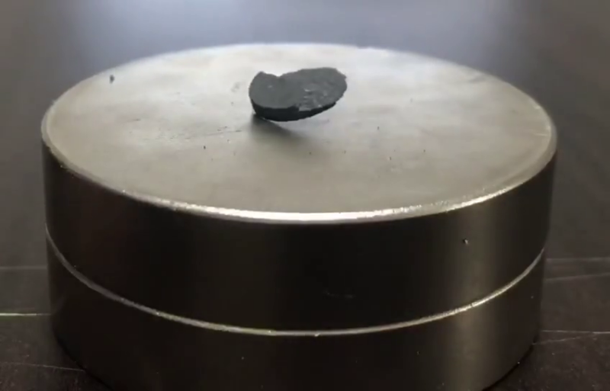
LK-99 – A room temperature superconductor?
Not up to speed? Here’s a decent overview
This is exciting! But why is it so hard to replicate?
Multiple labs and private individuals around the world are attempting to recreate the material that the authors have a hard time making reliably
Hyun-Tak Kim (CC BY 4.0)
Notes:
Something cool to talk about

Slide 10
The Replication Crisis in Science
Not just social and life sciences!
Resplandy et al., 2018 – “Quantification of ocean heat uptake from changes in atmospheric O₂ and CO₂ composition”
Data is available, attempting to come up with similar numbers falls short in original paper as noticed by a climate change skeptic
A problem of propagated errors
As science uses more moving parts, especially code, how can we ease the burden of fulfilling all of these dependencies?
Use software to ensure everyone uses the latest scientific conclusions?
Automatic updating of libraries?
Notes:
We want to shorten the time to science – make it easier for scientists to focus on things they’re interested in like science, and not things they aren’t, ex. code. (Unless you’re interested in code, then do that)
Automatic checking of libraries, auto updating for people:
Physical oceanography: TEOS-10 vs EOS-80
Chemical oceanography: ?

Slide 11
Solving the Sharing of Software and Data
What level of replicability is needed for software and data?
Loose code – search for a researcher’s personal website, hope the links are current and code installs neatly with minimal emails/forum searches?
Packaging –package manager, data centers?
System image – just boot up an image that contains everything you need?
Are current scientific best practices being followed?
Are the best science practices of the day being followed? Or are outdated libraries being used with ad-hoc fixes to make them current?
What is the minimum level of fuss a user should expect to encounter?
Language expert? No experience required?
Notes:
We cover how to do this in some detail in part 2, reproducible software. If the audience hasn’t thought about these questions yet, they should!
Insert graphic here for system image/packaging/website
What level of replicability is needed for software and data?
Loose code – search for a researcher’s personal website, hope the links are current and code installs neatly with minimal emails/forum searches?
Packaging – software installable via package manager, data via data centers?
System image – just boot up an image that contains everything you need?

Slide 12
FAIR Principles
Make data easier to use: “guidelines to improve the findability, accessibility, interoperability, and reuse of digital assets”
What does FAIR mean?
Findable
Accessible
Interoperable
Reusable
“Is your data FAIR?” vs “Does your data follow FAIR virtues?”
Absolutes versus relatives – start with the relatives
https://www.go-fair.org/fair-principles/
Notes:
FAIR is primarily about data – but you can find analogues in code.
How are other people able to decode and use your data?
----------
Findable The first step in (re)using data is to find them. Metadata and data should be easy to find for both humans and computers. Machine-readable metadata are essential for automatic discovery of datasets and services, so this is an essential component of the FAIRification process.
F1. (Meta)data are assigned a globally unique and persistent identifier
F2. Data are described with rich metadata (defined by R1 below)
F3. Metadata clearly and explicitly include the identifier of the data they describe
F4. (Meta)data are registered or indexed in a searchable resource
Accessible Once the user finds the required data, she/he needs to know how can they be accessed, possibly including authentication and authorisation.
A1. (Meta)data are retrievable by their identifier using a standardised communications protocol
A1.1 The protocol is open, free, and universally implementable
A1.2 The protocol allows for an authentication and authorisation procedure, where necessary
A2. Metadata are accessible, even when the data are no longer available
Interoperable The data usually need to be integrated with other data. In addition, the data need to interoperate with applications or workflows for analysis, storage, and processing.
I1. (Meta)data use a formal, accessible, shared, and broadly applicable language for knowledge representation.
I2. (Meta)data use vocabularies that follow FAIR principles
I3. (Meta)data include qualified references to other (meta)data
Reusable The ultimate goal of FAIR is to optimise the reuse of data. To achieve this, metadata and data should be well-described so that they can be replicated and/or combined in different settings.
R1. Meta(data) are richly described with a plurality of accurate and relevant attributes
R1.1. (Meta)data are released with a clear and accessible data usage license
R1.2. (Meta)data are associated with detailed provenance
R1.3. (Meta)data meet domain-relevant community standards
The principles refer to three types of entities: data (or any digital object), metadata (information about that digital object), and infrastructure. For instance, principle F4 defines that both metadata and data are registered or indexed in a searchable resource (the infrastructure component).

Slide 13
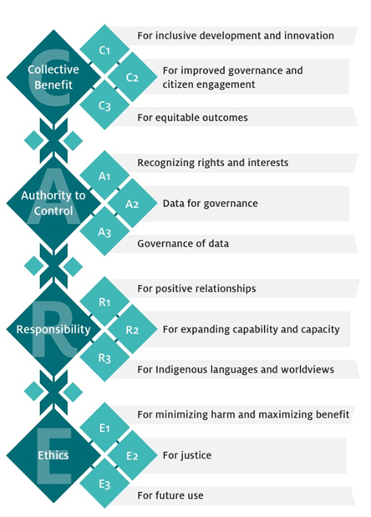
CARE Principles
Indigenous Peoples reaction to “data as the new oil”
A framework for respecting where data comes from
People and purpose oriented
https://www.gida-global.org/care

Slide 14
Reproducible Data: From Chaos to Results
Notes:
Part 2 – reproducible software. In this section we’ll cover some philosophical questions of making

Slide 15
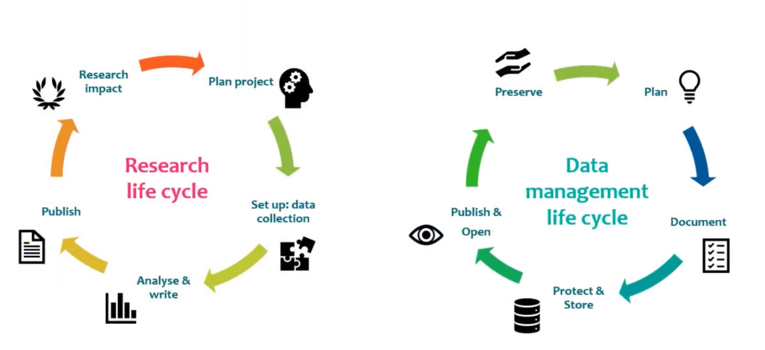
What is Scientific Data Management? (Diagram)
…only one of many higher level diagrams on data management!

Slide 16
Chain of Custody of Information
“Chain of custody” applies even in science!
Information collected in the wild or generated in a model
Data, metadata that’s been logged, verified
Results that’s been published and accessible
This includes code, papers, planning documents, etc.
How your data gets through the chain matters
Messy notebooks?
Non verified repositories?
Predatory journals?
End goal – trusting what you find, shortening “time to science”

Slide 17







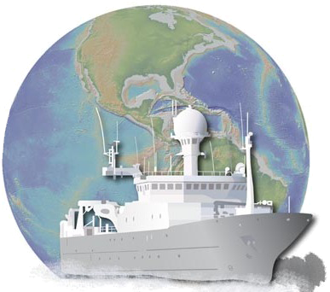

Data Centers/Repositories
Data centers are paid to make your data available – talk to us!
(It’s also a requirement of your grant to submit your data)
Use our libraries to read our data holdings, or ask us to make them
Feel free to contribute too!
Notes:
Where does your data go so that others can do analysis/perform your experiment?
You are responsible for making your data public, the data centers help you with making your data widely and easily available to the public.
A short listing of marine data centers, there are many more in other places.
If you are the data center, are you reaching out enough to your users (submitters and downloaders?)

Slide 18

Data Centers/Repositories, Part 2
Repositories come in different flavors
Generalist repositories – will accept anything and everything
Ex. Zenodo
Specialized repositories – focus on your field/specialty, supposed to stick around for some time
NSF Ocean Sciences approved repositories
CoreTrustSeal
A process that verifies repositories meet a minimum standard of requirements to be good holders of your data
Is there a repository for presentations on data management/repositories? 🤔
Notes:
Where does your data go so that others can do analysis/perform your experiment?
You are responsible for making your data public, the data centers help you with making your data widely and easily available to the public.
A short listing of marine data centers, there are many more in other places.
If you are the data center, are you reaching out enough to your users (submitters and downloaders?)

Slide 19
Repository of Methods – Ocean Best Practices
DOIs for manuals and handbooks
How to do fieldwork, make models, etc.
UNESCO/IOC project
Internationally agreed upon methods…
…and publically submitted methods
Journals: Best Practices in Ocean Observing, Deep Sea Research, etc.
https://www.oceanbestpractices.org/
Notes:
Where do the methods go so that someone can reproduce your experiment (if they can’t find your paper)?
Anyone can add to this website

Slide 20
Reproducible Software: Opinionated Practices with Python
Notes:
Part 2 – reproducible software. In this section we’ll cover some philosophical questions of making

Slide 21
Why spend effort for reproducibility?
Faster deployment of code
Faster understanding of code
Easier extension of code
It’s good for you and the community!
How can we measure reproducibility?
Read more than write – can you read it one month, year from now?
New installs over current- can you install it one month, year from now?
Code brittleness – can you extend it one month, year from now?
Notes:
Refactor effort for reproducibility.
The person attempting to measure may be you separated in time, or a different person at some point in space/time. Basically, how likely is a person going to be able to do anything with your code?
Code is like math (some may disagree and say code is math) – even if you speak in different languages, well structured code should be able to get across the same point with communications

Slide 22
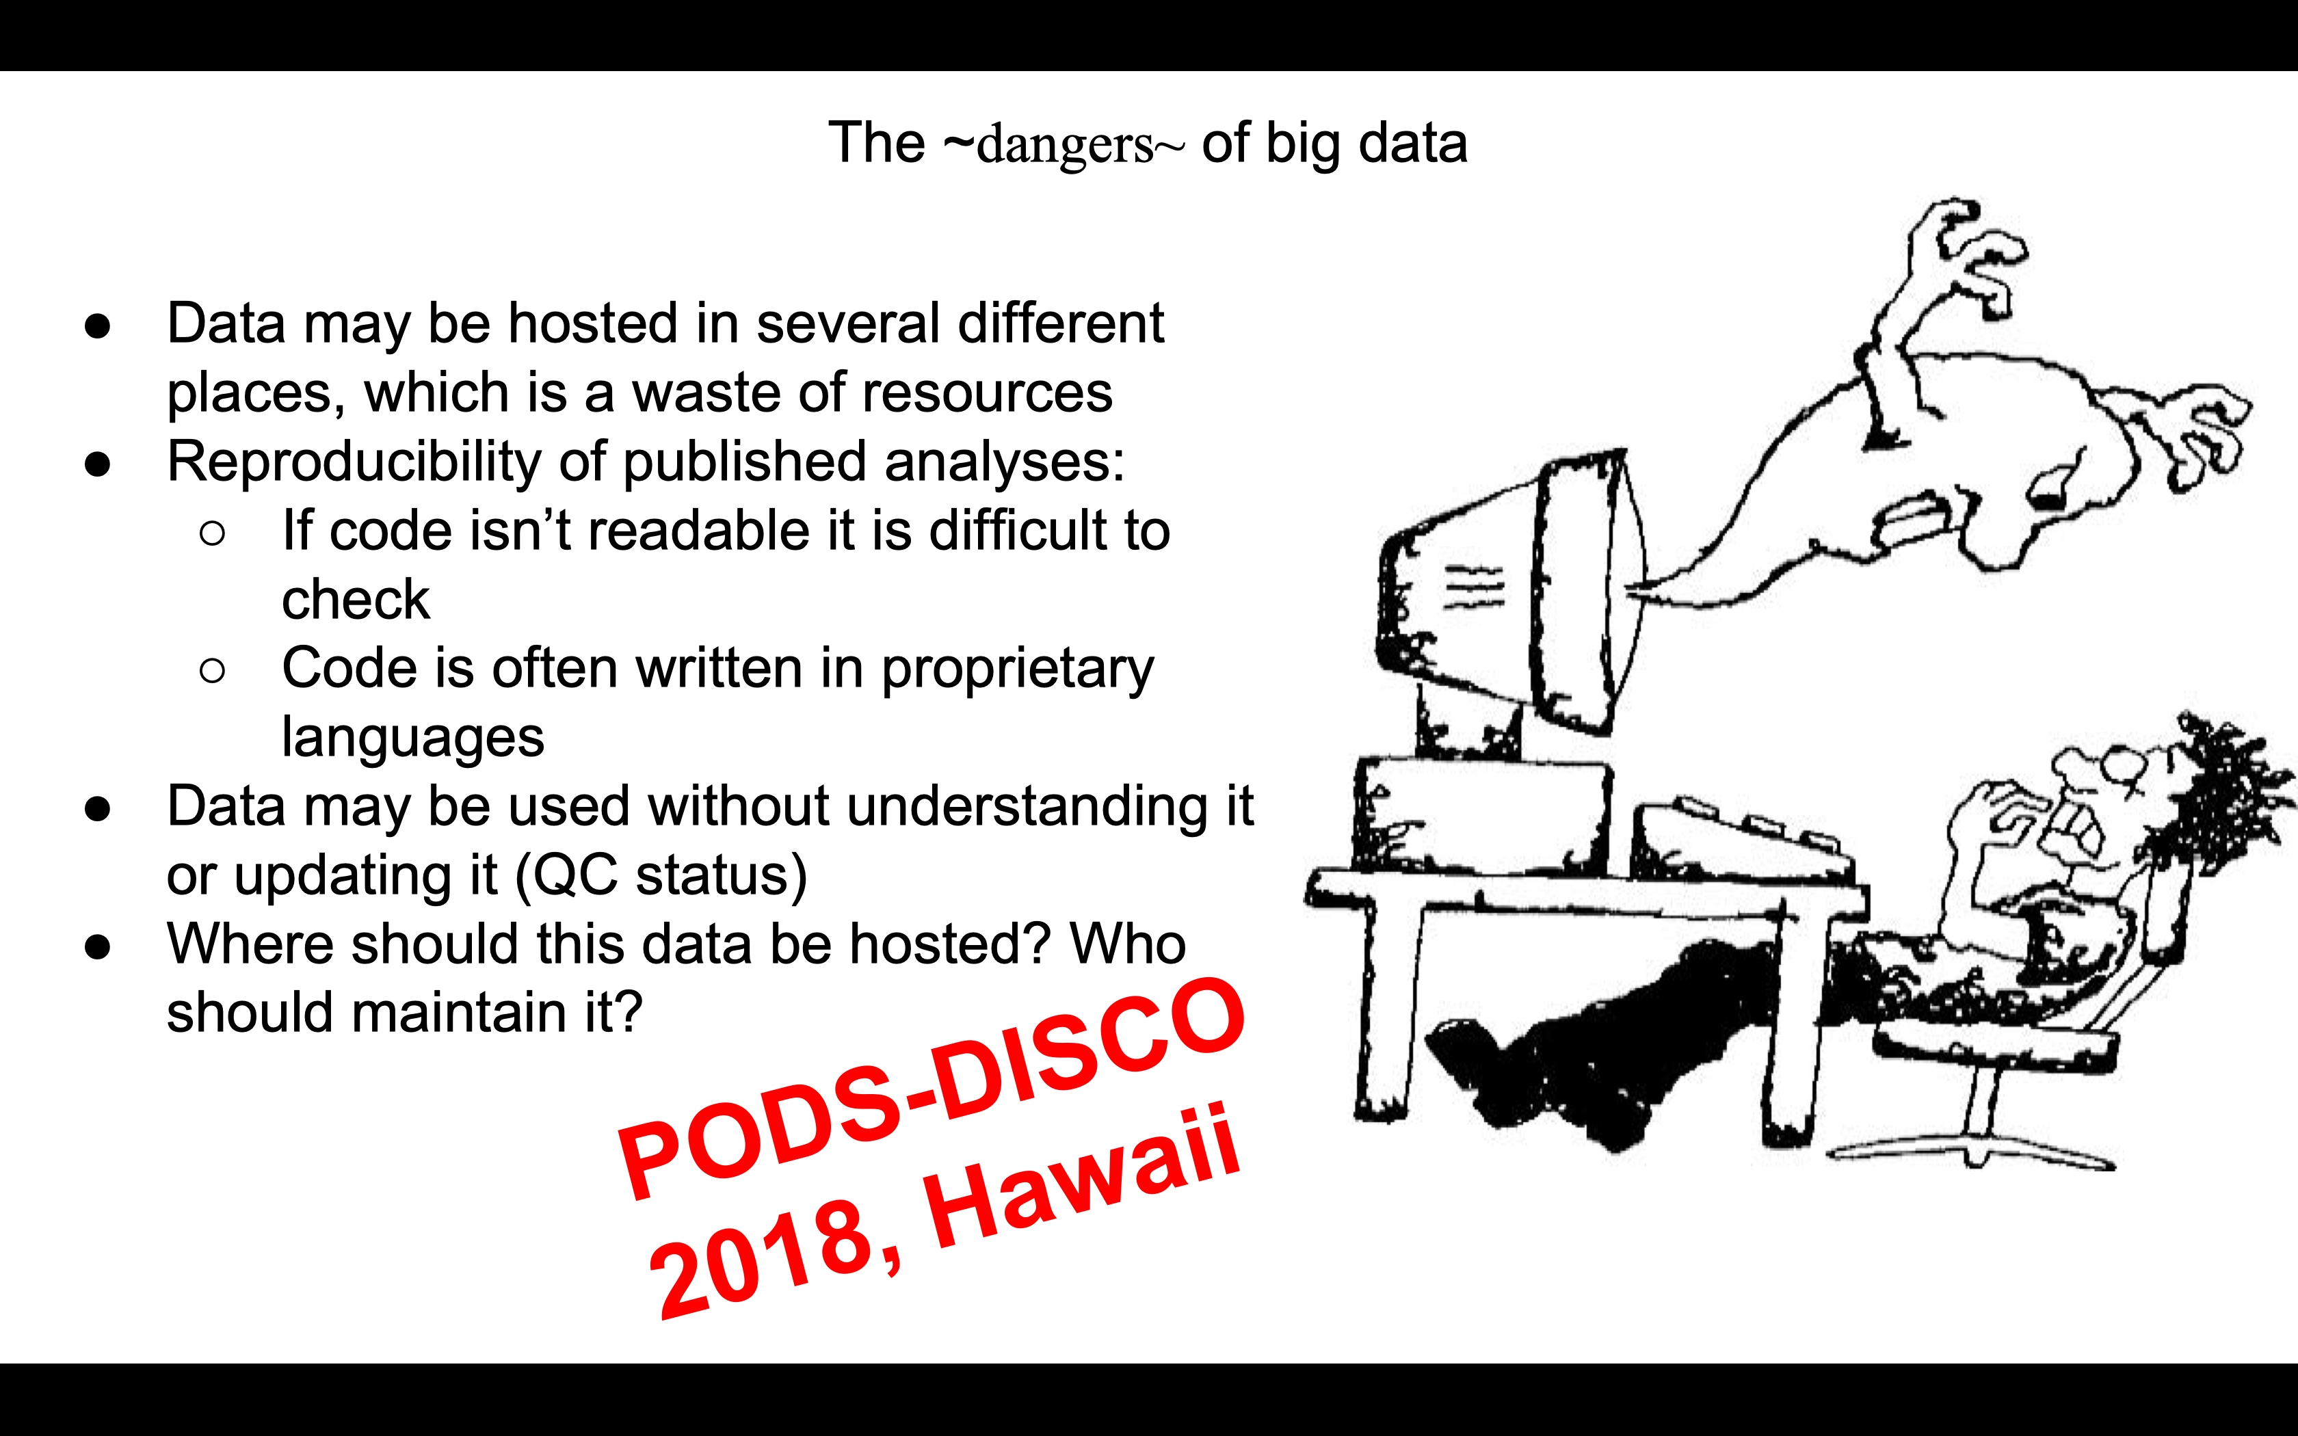
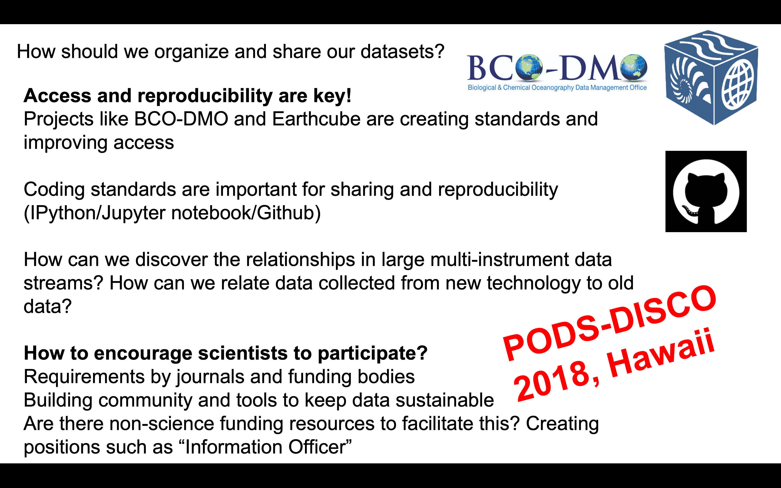
Lets see what some people have said about software, data before:

Slide 23
How do we standardize our coding practices?
“Opinionated” guidelines – PEP-20, ”This is the way we are doing things”
More people following the same opinionated practices – easier to share code!
Software tools to help write opinionated Python
Conda/Conda-forge
Black
isort (non-notebooks, production code)
Software tools to help facilitate opinionated Python
Git/Github
Binder
Sphinx (numpy docstrings)
Science decisions made by communities
netCDF-CF
Pangeo

Slide 24



Community Decisions - Oceanography
Formats: NetCDF (as opposed to CDF)
Backends: HDF5, NetCDF3, zarr (cloud native)
Formats: ASCII/CSV (old)
Easier for initial view, quickly lacking flexibility and metadata
Standard Vocabularies
Regulated vocabularies with strict definitions
Propose new names, pass committee approval
CF – Physical parameters (cf-xarray)
BODC lists – Biogeochemical parameters
Cloud: Pangeo
Standardizing environments to make it easier to run code

Slide 25


Working environments
Simplify installing and setting up an environment to run code
Compartmentalization makes it easier to prevent unforseen mixing that leads to problems
Package manager:
Conda + conda-forge: easier installation of dependencies, environments
Pip: standard Python tool; if all of your packages are in there, fine! (probably not)
Virtualization:
Conda provides virtual environments like virtualenv
Docker, other tools are good for deployment

Slide 26

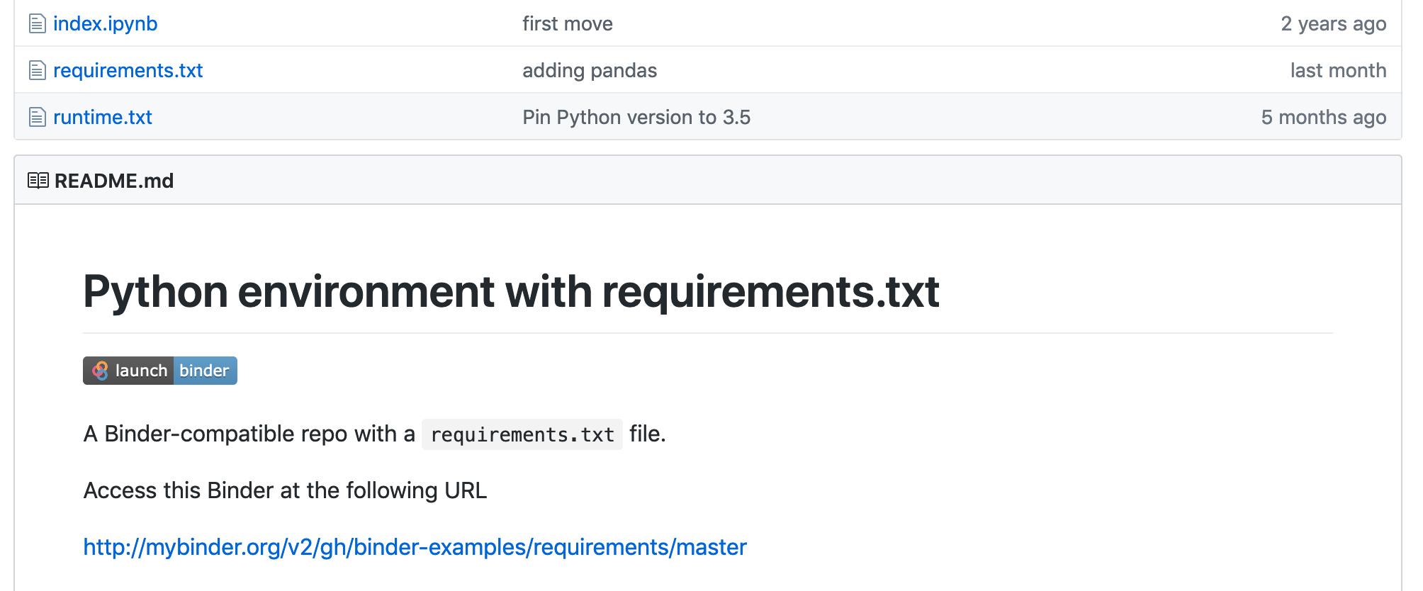
Binder
A platform for making notebooks runnable online
Plug-in to Github
Other platforms: Colab, Kaggle
Allow others to experiment with your code before downloading
Make DOI notebooks runnable

Slide 27

Version Control: git, Github
Easier to keep track of yours/others changes
Remote copies as failsafes in case of computer failure – but not a replacement for backups
Commits should be “atomic”
Commits are fully formed, not half-done
Related edits are grouped into a single commit
Commits are small (one change) and often
Use branches to try new ideas without polluting the master
Want more git tutorials?
Github – one of many places hosting code repos
"Piled Higher and Deeper" by Jorge Cham www.phdcomics.com

Slide 28

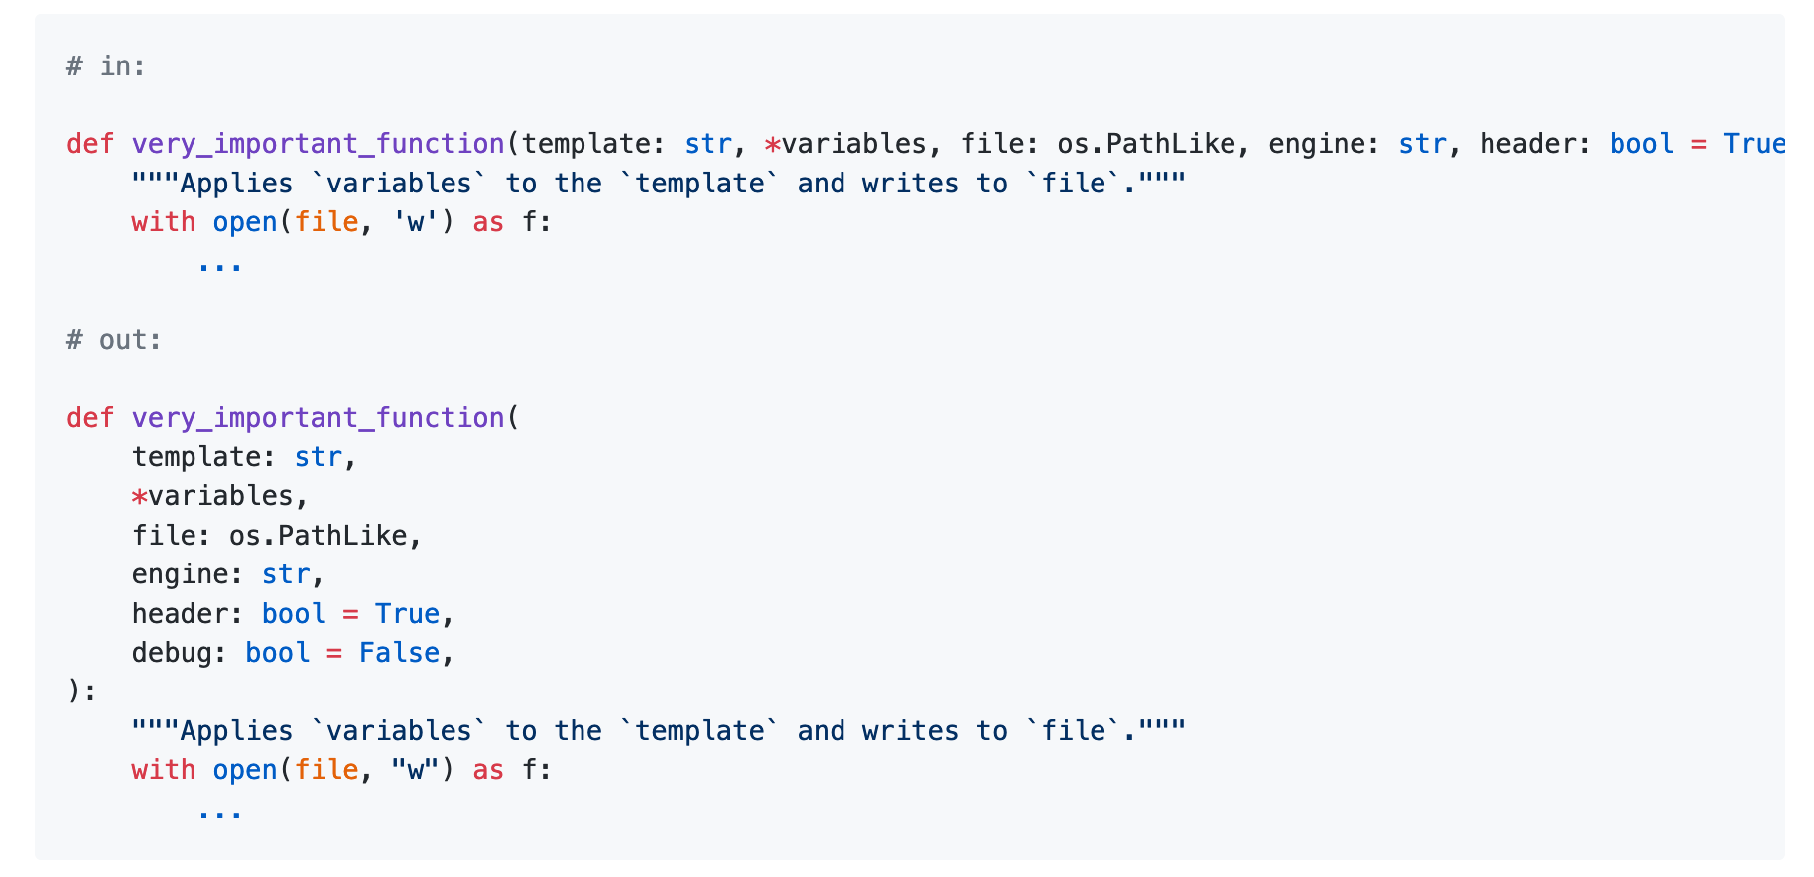
Code Formatting
Black: “The Uncompromising Code Formatter”
isort: Sort and trim imports; for production code, not notebooks

Slide 29
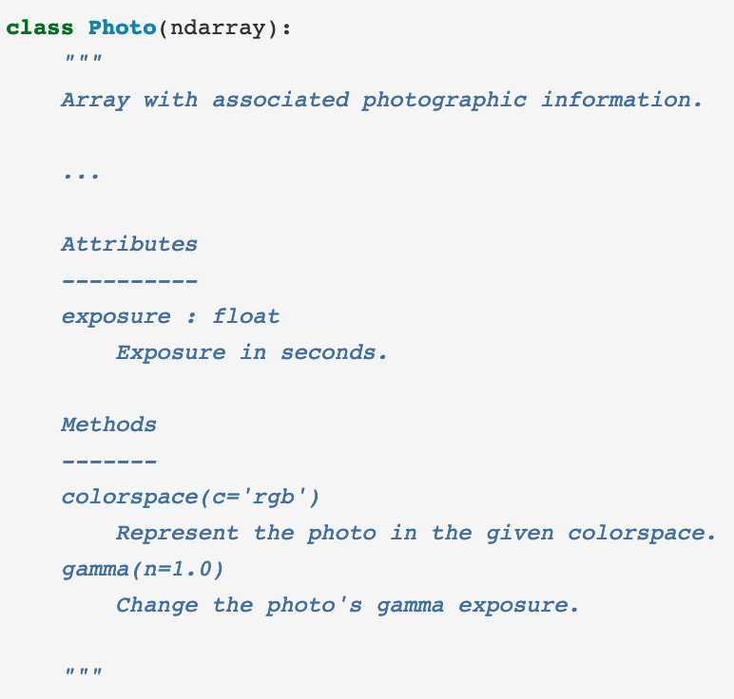

Code Readability part 2: comments and autodocs
Docstrings: format for writing documentation in Python
Flavors: Numpy, Google
Use numpy for your projects!
Document/Autodocs: Sphinx
Automatically generate code documentation
Make html, latex, pdf, plain text, etc.
Use with Read the Docs for free hosting
Themes: Read the Docs, Sphinx Book

Slide 30
Code readability – variable names
Context is important
Internal functions vs public API vs data products?
Equations implemented in code can make sense to use shorter names
Variable names
Temperature: temperature, temp, tmp, T, sea_water_temperature, sea_surface_skin_temperature, TEMPP681, TMESOT01
Those names in blue are from standard vocabularies
Controlled, publically available, names added after proposal process
Group Examples: CF, SeaVox, BODC
Someone should write a tool that checks files and converts to standard vocabulary names?

Slide 31



Advanced Software Engineering
Python language power features:
Decorators, factories, list comprehensions, etc.
APIs
Data: JSON, YAML, XML, REST, SOAP, etc.
Packaging
Version schemes
Continuous Integration (CI)
Special mention: Pre-commit
Tests
Unit, system/holistic
Images/Containers
“Better is the enemy of good”
Notes:
What standard libraries are available that you should be using?
Can you turn your software into something easily installable, ex. packaging in Python?
Continuous Integration is good for:
Unit tests are for single function/testing one small piece of the code (good for piecemeal changes), system/holistic tests are for testing the system does what you want as a whole. You should have both, but system tests are more important IMO. Also exists but not mentioned is integration testing

Slide 32




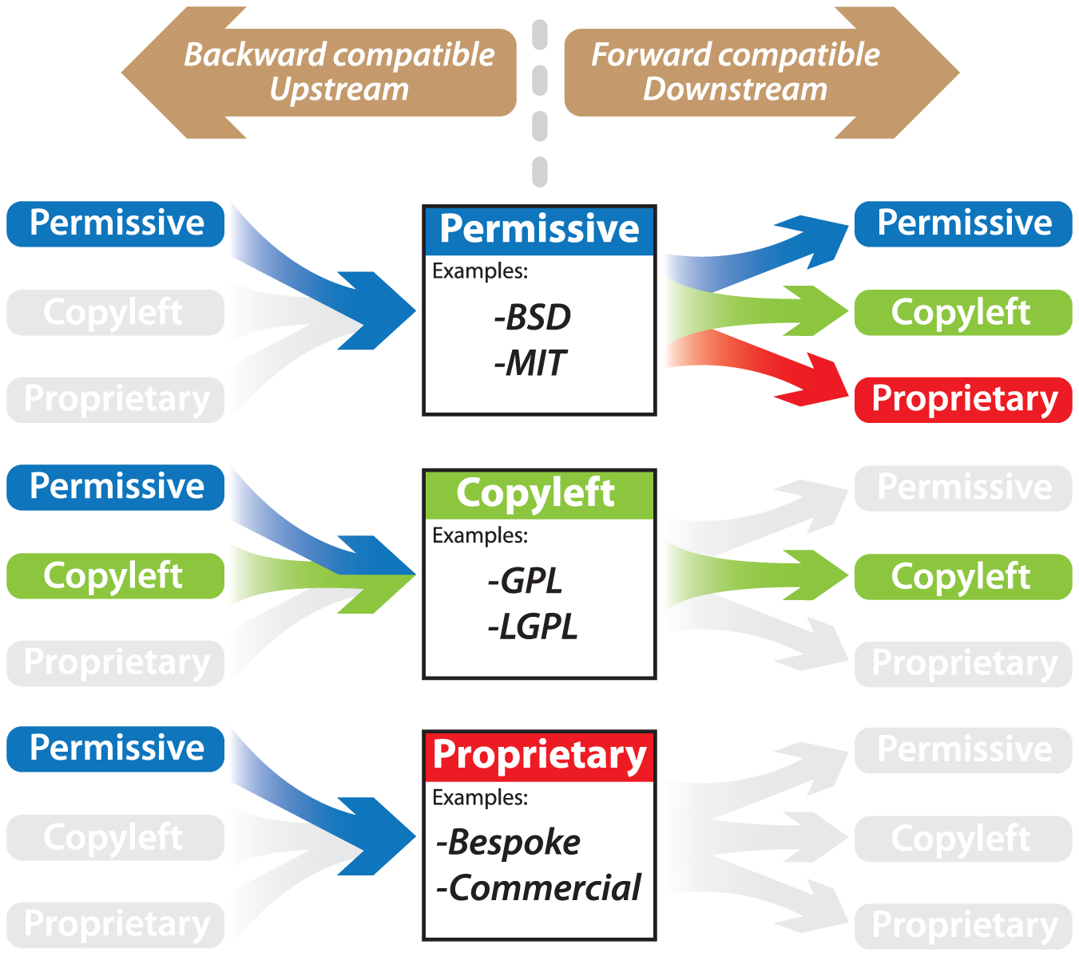
Licensing Code and Datasets
Tool to help you choose: https://choosealicense.com/
Software: MIT, BSD
Data: CC
USA federal government data licenses: ODC, CC, GNU (Federal only)
Publically funded data must be open access, data centers may license holdings
If no license is stated, a proprietary license is assumed - “all rights reserved”
doi: https://doi.org/10.1371/journal.pcbi.1002598.g002
Notes:
US Copyright act of 1976: Federal data must be licensed as one of the “USA government data licenses”
Data centers may license holdings like this: https://www.bco-dmo.org/terms-use “All data sets are licensed under a Creative Commons Attribution 4.0 International License”

Slide 33



DOIs for Fun and Profit: Pt. 1
DOI – Digital Object Identifier, can be made by many organizations
Your institution may do so, but you don’t need to use them
Zenodo is broadly available for all
Making DOIs for code
https://guides.github.com/activities/citable-code/
Making DOIs for data
https://www.zenodo.org/
Your institution may be able to make DOIs
Notes:
Making DOIs:
Zenodo – part of CERN, EU
CERN produces 25 PB/year when LHC is running, all storage needs related to Zenodo are “a drop in the ocean” compared to CERN

Slide 34
DOIs for Fun and Profit: Pt. 2
Citing DOIs:
Zenodo: lets look at 10.5281/zenodo.1256998
Choose citation style
Online tool: https://citation.crosscite.org/
10.7942/C2008W, “american-geophysical-union”, “en-US”
These tools depend on the DOI fields being filled out properly, so you don’t have to manually form them
Otherwise, follow recommended style
Notes:
Citing DOIs:

Slide 35
Questions?
Want the slides? (DOI coming)
https://github.com/asx-/reproducible-science
Notes:
https://github.com/asx-/reproducible-science

Slide 36
Epilogue: Why make Open Source Software?
Requirements
Your funder probably requires publicly available results including data and software
One common exception: military funded projects
Collaboration
Connect with others using the same software, work together on projects
Publishing
Your code are your methods, especially for computationally intensive projects, and should be auditable by others
Maintainability
As a project grows, someone may possibly maintain your software for free!

Slide 37
Appendix A: Python Libraries You Might Not Be Using But Should
Official Standard Libraries
Exceptions – Catch warnings and errors and not fail
Logging – Put logs out to files, different priority levels instead of print statements
Pathlib – Current and easy way of interacting with paths
Pdb – Python debugger
Community Standard Libraries
Pytest – Testing framework
SciPy Stack – basic tools for scientific computing
Plotting – Cartopy, Holoviews, Matplotlib
Cloud Data – xarray, dask, zarr
(Bonus) NumFOCUS – Foundation that funds a number of science focused Python projects and other software
Notes:
The community standard libraries (with the exception of pytest) represent a sampling of packages commonly used in geosciences that are broadly applicable to other sciences/Python at large. Specifics for your discipline are not included here.

Slide 38
Appendix B: Resources for improving (digital) reproducible science
Carpentries Project
Software
Data
OceanHackWeek
2018, 2019
Notes:
The community standard libraries (with the exception of pytest) represent a sampling of packages commonly used in geosciences that are broadly applicable to other sciences/Python at large. Specifics for your discipline are not included here.

Slide 39
Appendix C: Arguments for Open Source
Open Source means open to collaboration, distributed efforts:
New opportunities for unknown collaborators to join
Distributed costs – instead of one project funding 1 FTE, 4 projects funding 0.3 FTEs
Redundancy in maintenance – One person on holiday, retiring, etc. does not bring the entire project down
Easier hiring – pay other maintainers to add new features, find other developers working on similar projects able to add to the software, find private industry programmers to help more easily - https://science.mozilla.org/projects
Journals and repositories are moving towards mandated shared code and data – move ahead of the curve early
Notes:
We anticipate there will be some questions about getting scooped or losing the 'competitive' advantage by releasing code.
It would be helpful for you to talk about how OSS has enabled the efficiency of your science, broadened your community, more collaborations, etc...

Slide 40
Appendix D: Shiny is to R as ??? is to Python?
Quickly turn Python code into a web dashboard
Streamlit - https://streamlit.io/docs/index.html
Dash - https://dash.plot.ly/introduction

